Slide 1
PWM-PULSE WIDTH MODULATION
Dr.Sreejith Rajan

Slide 2
PWM
PWM = a method to control the average power delivered to a device by switching a digital signal ON and OFF very fast.
The “on-time” ratio (duty cycle) controls the effective output.
The frequency is high enough that the load (LED, motor, etc.) only sees a smooth average voltage.

Slide 3
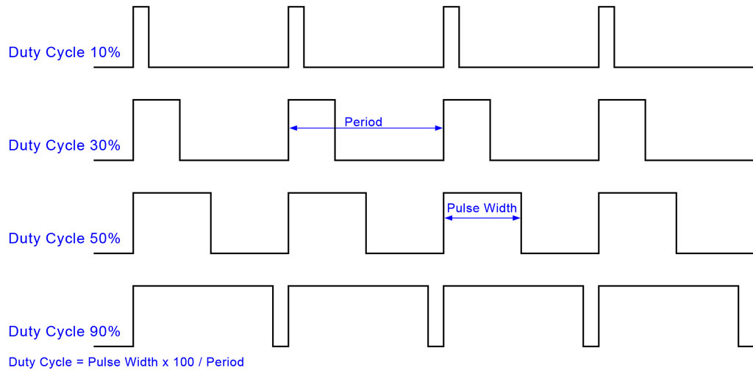
PWM

Slide 4
PWM Frequency
F_{pwm} = F_{clk}/(N x 256)
N= Prescalar

Slide 5
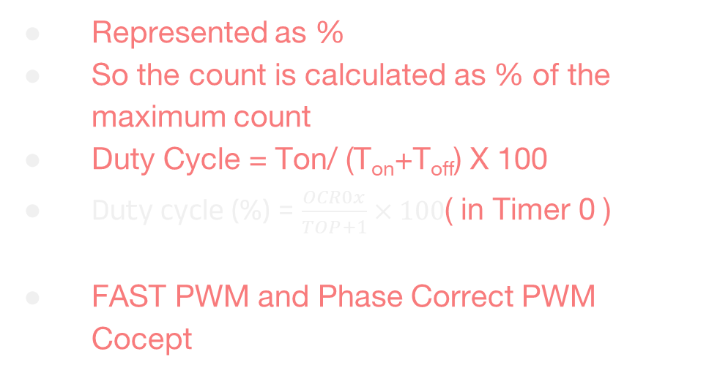
PWM duty cycle
Represented as %
So the count is calculated as % of the maximum count
Duty Cycle = Ton/ (T_{on}+T_{off}) X 100
Duty cycle (%) = $\frac{OCR0x}{TOP+1}×100$( in Timer 0 )
FAST PWM and Phase Correct PWM Cocept

Slide 6
Inverting and Noninverting PWM
// Non-inverting COM0A1 =1
TCCR0A |= (1 << COM0A1);
// Inverting COM0A1 AND COM0A0 =1
TCCR0A |= (1 << COM0A1) | (1 << COM0A0);

Slide 7
AVR Timer

Slide 8
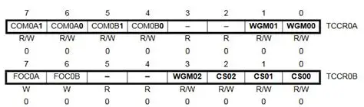
ATMEGA 328 TCCR 0

Slide 9
Let us Code

Slide 10
THANK YOU

